Slide 1
Virtualization: I/O
Yubin Xia
Software School
Shanghai Jiao Tong University
Some Slides adapted from VMWare’s academic course plan

Slide 2
Review: CPU Virtualization
Trap and Emulation
Instruction Interpretation
Binary Translation
Para-virtualization
New Hardware (to fix the 17 instructions)

Slide 3
Case Study: KVM & QEMU

Slide 4
KVM Introduction
KVM runs as a Linux module (/dev/kvm)
Leverage Linux functions
E.g., memory management, process scheduling
Leverage hardware virtualization
Trap and emulate: for all the privileged instructions
Leverage EPT for address translation between GVA, GPA, HPA
I/O virtualization
Leverage Qemu for convenience
Leverage SR-IOV for performance
Virtio for para-virtualization

Slide 5
KVM History
Began development at Qumranet, bought by RedHat later 2008
Merged to kernel in Feb 2007
Also be ported to FreeBSD
Now support x86, S/390, PowerPC, IA-64, ARM
Support a lot of guest OSes without modification
VirtIO: a paravirtualization device driver now work for Linux, *BSD, Plan 9 and Windows

Slide 6
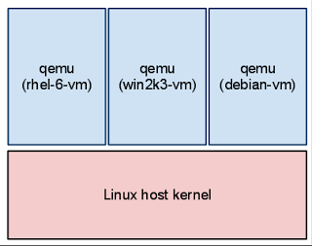
In KVM, VM is Just a Qemu Process
Create VMs by running the qemu program
Aka., qemu-kvm or kvm
On a host that is running 3 VMs there are 3 qemu processes
VM shut down, Qemu exits
Reboot without restart qemu

Slide 7
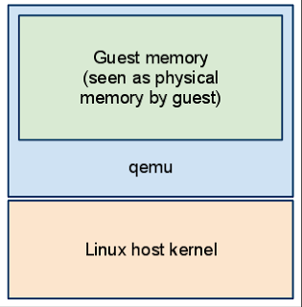
Allocate Memory as Guest Physical Memory
Qemu allocates memory
The memory acts as the "physical" memory as seen by the guest

Slide 8
KVM Basic Flow
Use /dev/kvm to operate hardware virtualization
ioctl with different parameters
CREATE_VM, CREATE_VCPU, RUN, etc.

Slide 9
Qemu-kvm Basic Flow
open("/dev/kvm")
ioctl(KVM_CREATE_VM)
ioctl(KVM_CREATE_VCPU)
for (;;) {
ioctl(KVM_RUN)
exit_reason = get_exit_reason();
switch (exit_reason) {
case KVM_EXIT_IO: /* ... */
break;
case KVM_EXIT_HLT: /* ... */
break;
}
}
Invoke VMENTRY

Slide 10
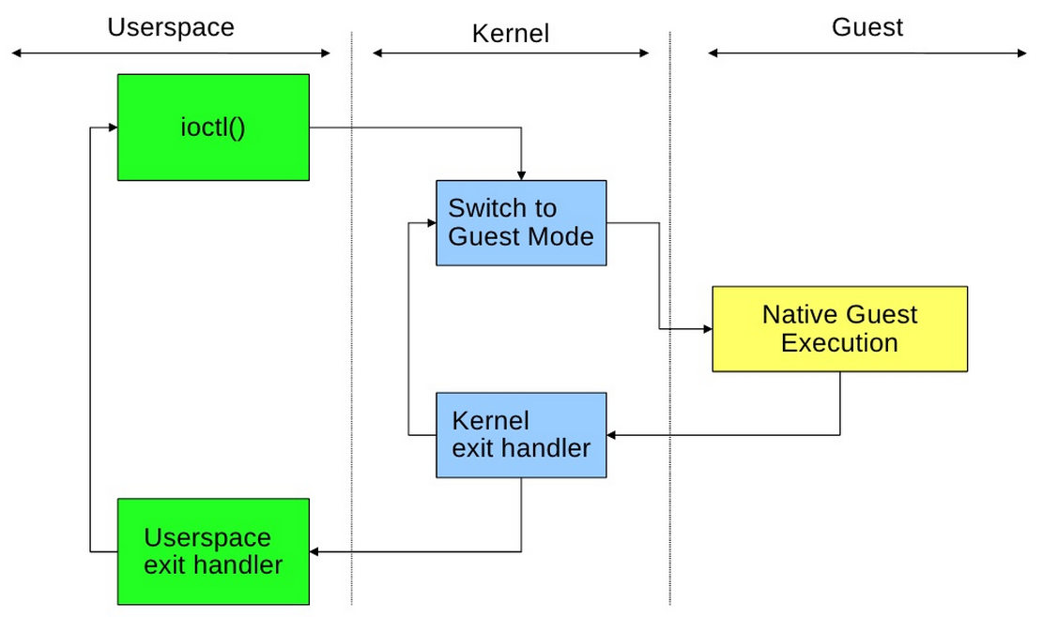
KVM Execution

Slide 11
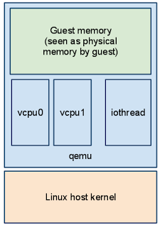
Qemu Process Seen from the Host
Host kernel schedules Qemu as a regular process
Host cannot see the processes running inside the guest
Guests have a vcpu thread per virtual CPU
A dedicated iothread runs a select() event loop to process I/O such as network packets and disk I/O completion

Slide 12
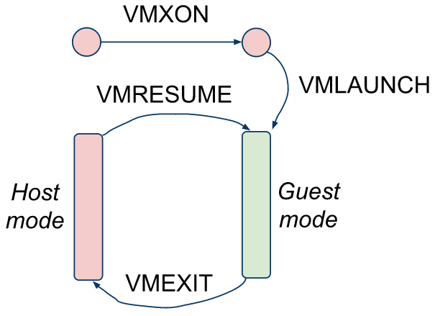
What Happens After ioctl(KVM_RUN)?
The kernel find the VMCS data structure
Load VMCS to processor by VMENTRY
The processor switches from root-mode to non-root
The IP is changed to VMCS->IP, and start to run guest VM’s code

Slide 13
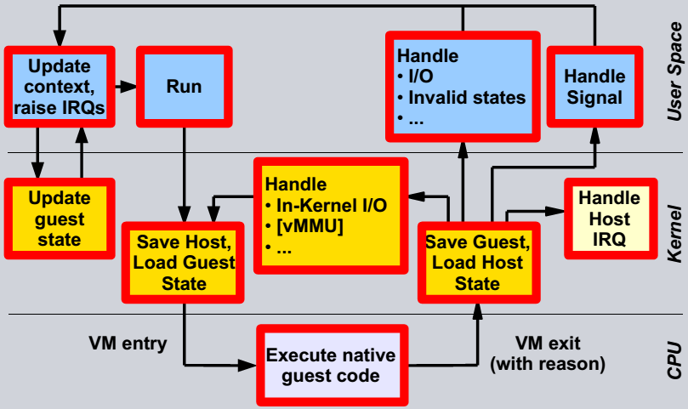
VCPU Execution Flow (KVM View)

Slide 14
Architectural Advantages of the KVM Model
Proximity of guest and user space hypervisor
Only one address space switch: guest ↔ host
Less rescheduling
Massive Linux kernel reuse
Scheduler, Memory management with swapping, I/O stacks
Power management, Host CPU hot-plugging, …
Massive Linux user land reuse
Network configuration
Handling VM images
Logging, tracing, debugging

Slide 15
I/O Virtualization

Slide 16
Device Virtualization
Emulated
Para-virtualized
Direct Access (Passthrough)
Hardware assisted I/O virtualization

Slide 17
Emulated Device

Slide 18
Abstraction & Virtualization
Applications or OS
Application uses virtual disk as Real disk
Virtualized Disk
Virtualization
File
File
Abstraction
Real Disk

Slide 19
Emulated Devices
Emulate a device in class
Emulated registers
Memory mapped I/O or programmed I/O
Convert
Intermediate representation
Back-ends per real device

Slide 20
Serial Port Example
User App
Serial Chip
ABC
Emulation
Guest
Generic Serial Layer
Serial Chip
ABC Driver
Host OS
Monitor
Serial Chip XYZ
LAN

Slide 21
Xen’s Domain-0 (Full-Virtualization)
Qemu for device emulation
User-level application running in domain-0
Implement NIC (e.g., 8139) in software
Each VM has its own Qemu instance running
I/O request redirection
Guest VM’s I/O requests are sent to domain-0
Then Domain-0 sends to Qemu
Eventually, Qemu will use domain-0’s NIC driver

Slide 22
Emulated Devices
Positives
Platform stability
Allows interposition
No special hardware support needed
Isolation, multiplexing implemented by monitor
Negatives
Can be slow
Drivers needed in monitor or host

Slide 23
Para-Virtualization

Slide 24
Para-Virtualized Devices
Guest passes requests to Monitor at a higher abstraction level
Monitor calls made to initiate requests
Buffers shared between guest / monitor
Positives
Simplify monitor
Fast
Negatives
Monitor needs to supply guest-specific drivers
Bootstrapping issues

Slide 25
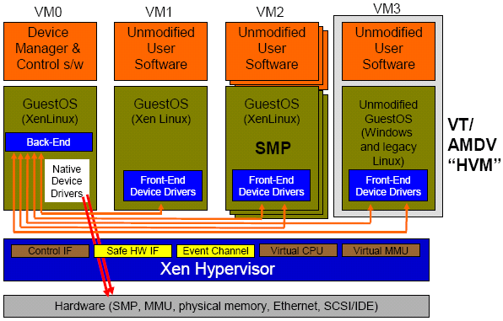
Para-virtualized Devices: Front-end/Back-end
Para –virtualization
Linux Guest
Hardware-supported virtualization
Unmodified Windows
Isolated Device Drivers
Source: Ottawa Linux Symposium 2006 presentation.
http://www.cl.cam.ac.uk/netos/papers/

Slide 26
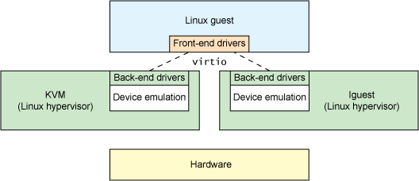
VirtIO: Unified Para-virtualized I/O
Motivation: Linux has support for at least 8 virtualization platforms, each with its own para-virtualized I/O design/interfaces
VirtIO: to provide a unified I/O mode for para-virtualized device
Adopted by KVM and lguest
Figure from: http://www.ibm.com/developerworks/cn/linux/l-virtio/figure2.gif

Slide 27
Virtio in KVM
Virtio is a framework and set of drivers
A hypervisor-independent, domain-independent, bus-independent protocol for transferring buffers
A binding layer for attaching virtio to a bus (e.g., PCI)
Domain specific guest drivers (networking, storage, etc.)
Hypervisor specific host support

Slide 28
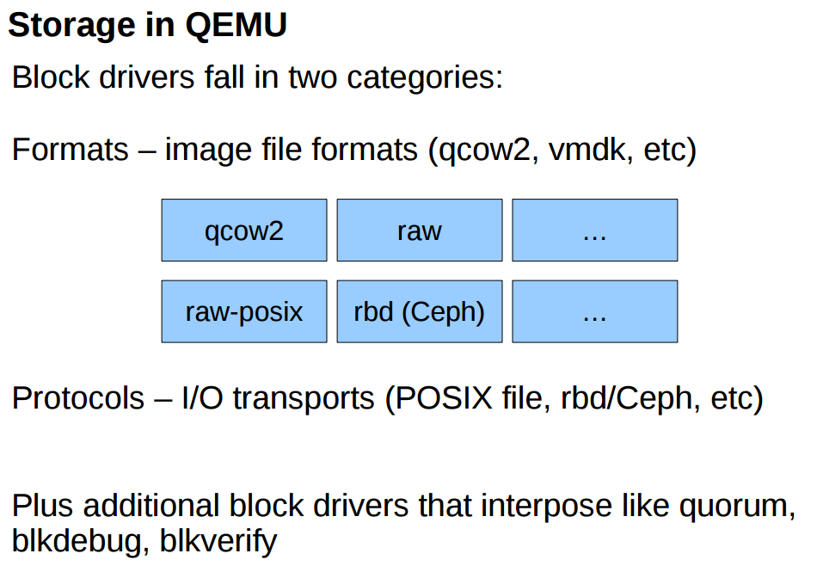

Slide 29
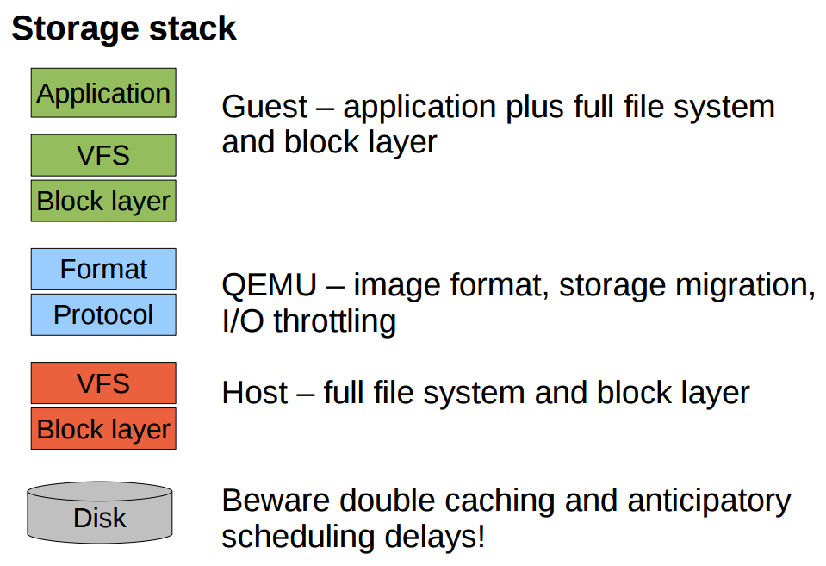

Slide 30
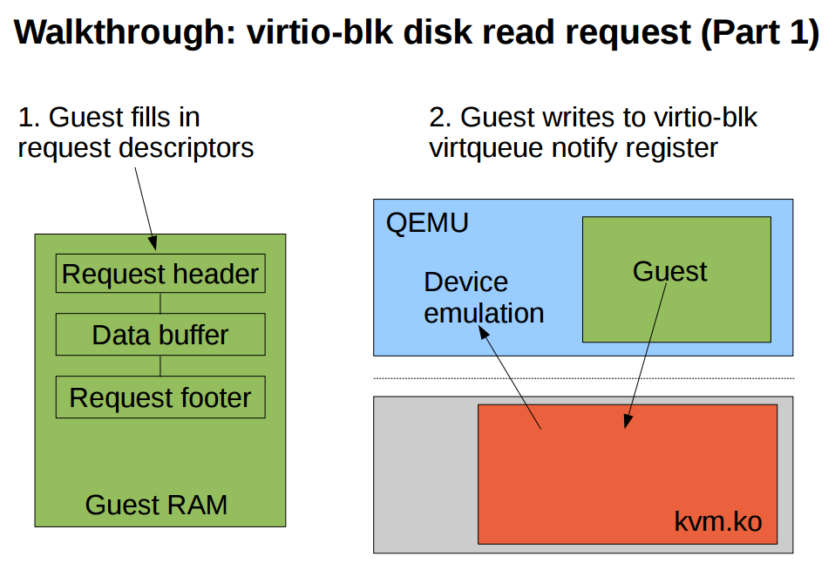

Slide 31
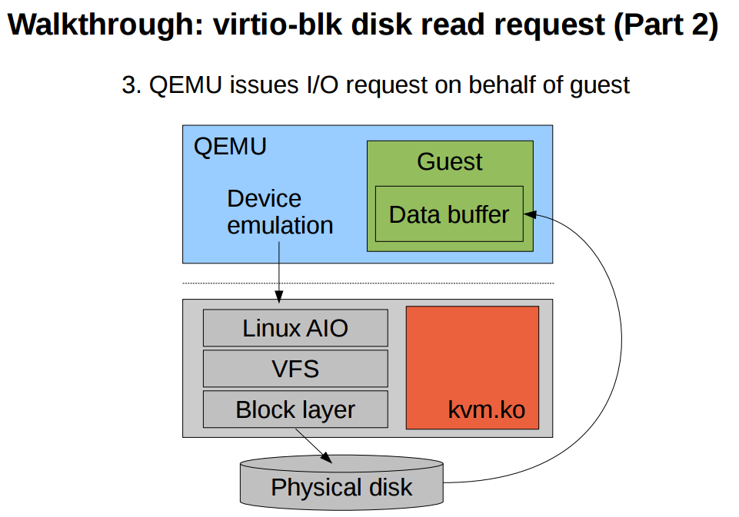

Slide 32
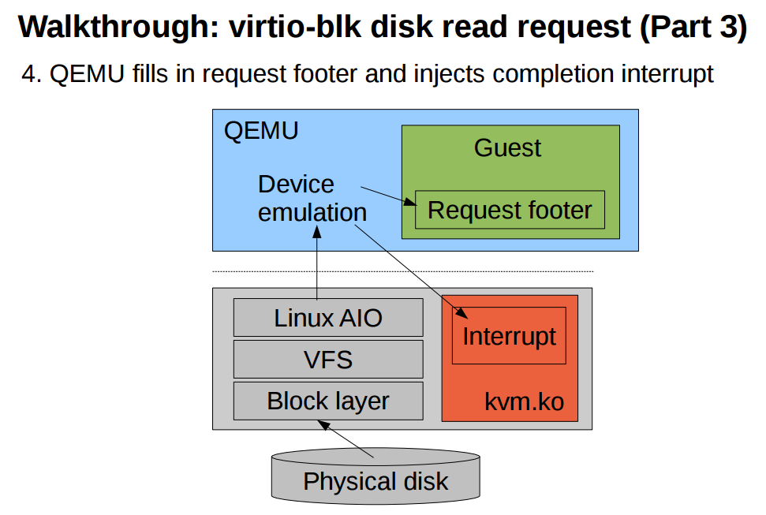

Slide 33
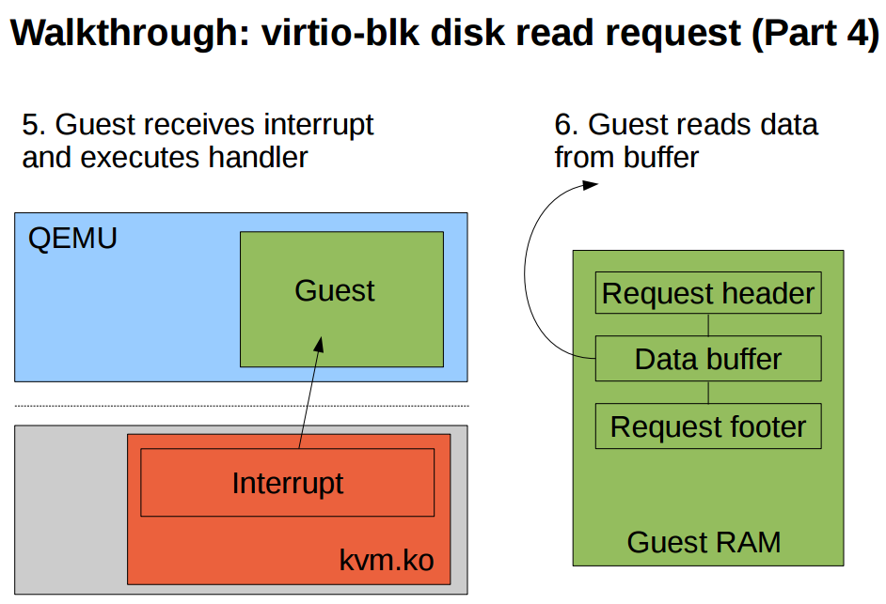

Slide 34
Hardware assisted

Slide 35
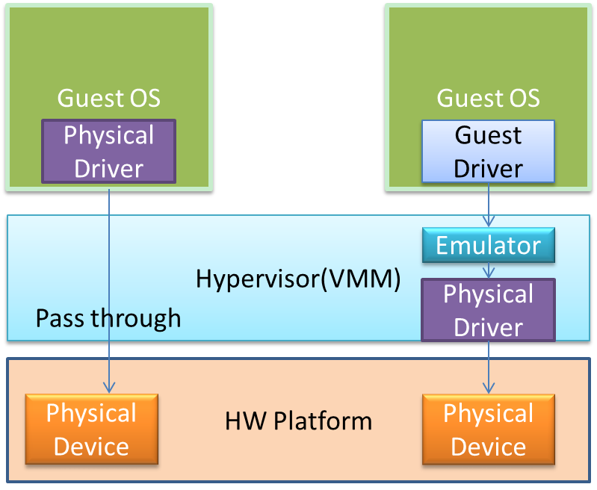
Directed I/O
Software-based sharing adds overhead to each I/O due to emulation layer
This indirection has the additional affect of eliminating the use of hardware acceleration that may be available in the physical device.
Directed I/O has added enhancements to facilitate memory translation and ensure protection of memory that enables a device to directly DMA to/form host memory.
Bypass the VMM’s I/O emulation layer
Throughput improvement for the VMs

Slide 36
Direct Access Device Virtualization
Allow Guest OS direct access to underlying device
Positives
Fast
Simplify monitor
Limited device drivers needed
Negatives
Need hardware support for safety (IOMMU)
Need hardware support for multiplexing
Hardware interface visible to guest
Limits mobility of VM
Interposition hard by definition

Slide 37
Issues to Address
I/O address translation
How to translate I/O address to host physical address
Interrupt mapping
How to route an interrupt correctly to a guest VM
Device multiplexing
How to multiplex a single hardware device among multiple VMs
Mostly importantly
Provide strong isolation, while reduce hypervisor involvement

Slide 38
VT-d: Intel® Virtualization Technology for Directed I/O
Provides the capability to ensure improved isolation of I/O resources for greater reliability, security, and availability.
Supports the remapping of I/O DMA transfers and device-generated interrupts.
Provides flexibility to support multiple usage models that may run un-modified, special-purpose, or "virtualization aware" guest OSs.

Slide 39
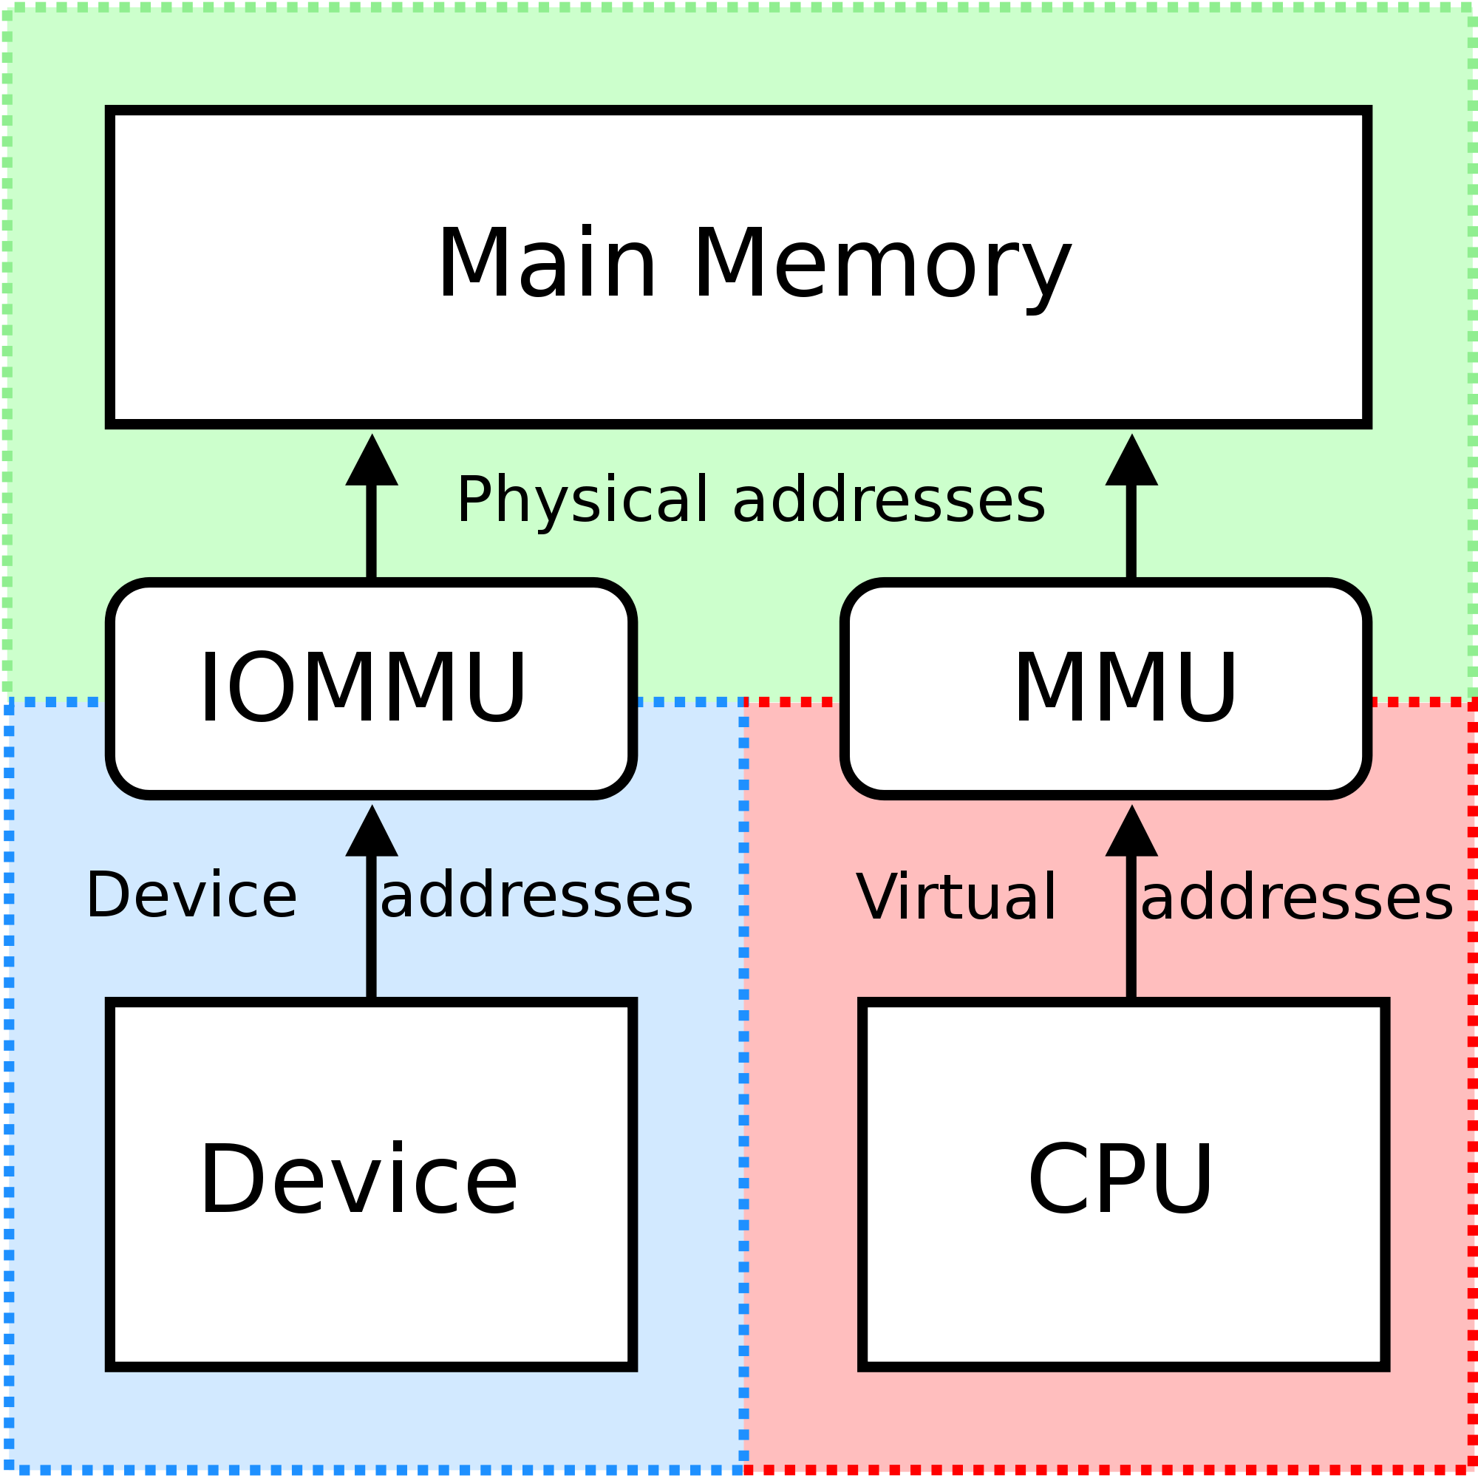
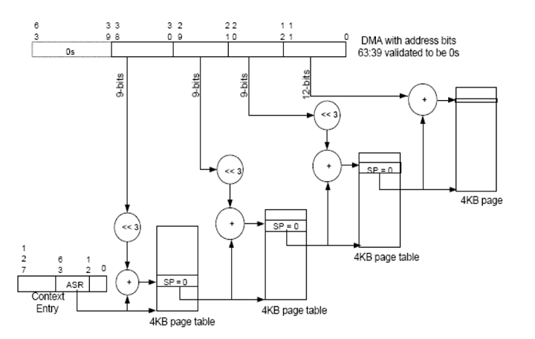
Address Translation Services
VT-d architecture defines a multi-level page-table structure for DMA address translation
The multi-level page tables are similar to IA-32 processor page-tables, enabling software to manage memory at 4 KB or larger page granularity
Notes:
VT-d architecture defines a multi-level page-table structure for DMA address translation.The multi-level page tables are similar to IA-32 processor page-tables, enabling software to manage memory at 4 KB or larger page granularity. Hardware implements the page-walk logic and traverses these structures using the address from the DMA request. The number of page-table levels that must be traversed is specified through the context-entry referencing the root of the page table. The page directory and page-table entries specify independent read and write permissions, and hardware computes the cumulative read and write permissions encountered in a page walk as the effective permissions for a DMA request. The page-table and page-directory structures are always 4 KB in size, and larger page sizes (2 MB, 1 GB, etc.) are enabled through super-page support.

Slide 40
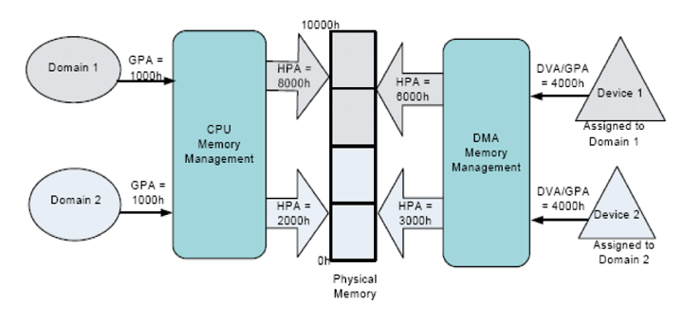
DMA Remapping
DMA-remapping translates the address of the incoming DMA request to the correct physical memory address and perform checks for permissions to access that physical address
DMA-remapping hardware logic in the chipset sits between the DMA capable peripheral I/O devices and the computer’s physical memory
Notes:
Intel VT-d enables protection by restricting direct memory access (DMA) of the devices to pre-assigned domains or physical memory regions. This is achieved by a hardware capability known as DMA-remapping. The VT-d DMA-remapping hardware logic in the chipset sits between the DMA capable peripheral I/O devices and the computer’s physical memory. It is programmed by the computer system software. In a virtualization environment the system software is the VMM. In a native environment where there is no virtualization software, the system software is the native OS. DMA-remapping translates the address of the incoming DMA request to the correct physical memory address and perform checks for permissions to access that physical address, based on the information provided by the system software.
Intel VT-d enables system software to create multiple DMA protection domains. Each protection domain is an isolated environment containing a subset of the host physical memory. Depending on the software usage model, a DMA protection domain may represent memory allocated to a virtual machine (VM), or the DMA memory allocated by a guest-OS driver running in a VM or as part of the VMM itself. The VT-d architecture enables system software to assign one or more I/O devices to a protection domain. DMA isolation is achieved by restricting access to a protection domain's physical memory from I/O devices not assigned to it by using address-translation tables. This provides the necessary isolation to assure separation between each virtual machine’s computer resources.
When any given I/O device tries to gain access to a certain memory location, DMA remapping hardware looks up the address-translation tables for access permission of that device to that specific protection domain. If the device tries to access outside of the range it is permitted to access, the DMA remapping hardware blocks the access and reports a fault to the system software.

Slide 41
VT-d Feature: Interrupt Remapping
The interrupt requests generated by I/O devices must be controlled by the VMM
When the interrupt occurs, the VMM must present the interrupt to the guest. This is not accomplished through hardware.
The VT-d interrupt-remapping architecture addresses this problem by redefining the interrupt-message format.
Interrupt requests specify a requester-ID and interrupt-ID, and remap hardware transforming these requests to a physical interrupt.
Notes:
For proper device isolation in a virtualized system, the interrupt requests generated by I/O devices must be controlled by the VMM. In the existing interrupt architecture for Intel platforms, a device may generate either a legacy interrupt (which is routed through I/O interrupt controllers) or may directly issue message signaled interrupts (MSIs) [20]. MSIs are issued as DMA write transactions to a pre-defined architectural address range, and the interrupt attributes (such as vector, destination processor, delivery mode, etc.) are encoded in the address and data of the write request. Since the interrupt attributes are encoded in the request issued by devices, the existing interrupt architecture does not offer interrupt isolation across protection domains.
The VT-d interrupt-remapping architecture addresses this problem by redefining the interrupt-message format. The new interrupt message continues to be a DMA write request, but the write request itself contains only a "message identifier" and not the actual interrupt attributes. The write request, like any DMA request, specifies the requester-id of the hardware function generating the interrupt.
DMA write requests identified as interrupt requests by the hardware are subject to interrupt remapping. The requestor-id of interrupt requests is remapped through the table structure. Each entry in the interrupt-remapping table corresponds to a unique interrupt message identifier from a device and includes all the necessary interrupt attributes (such as destination processor, vector, delivery mode, etc.). The architecture supports remapping interrupt messages from all sources including I/O interrupt controllers (IOAPICs), and all flavors of MSI and MSI-X interrupts defined in the PCI specifications. (there is no mention of legacy interrupts) For more info about MSI refer to: http://lwn.net/Articles/44139/

Slide 42
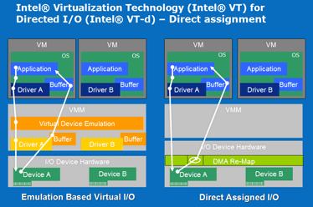
Interrupt Remapping

Slide 43
Drawbacks to Directed I/O
One concern with direct assignment is that it has limited scalability
A physical device can only be assigned to one VM.
For example, a dual port NIC allows for direct assignment to two VMs. (one port per VM)
Consider for a moment a fairly substantial server of the very near future
4 physical CPU’s
12 cores per CPU
If we use the rule that one VM per core, it would need 48 physical ports.

Slide 44
Device multiplexiing: Single Root I/O Virtualization
Single Root I/O Virtualization (SR-IOV) is a Peripheral Component Interconnect Special Interest Group (PCI-SIG) specification.
SR-IOV provides a standard mechanism for devices to advertise their ability to be simultaneously shared among multiple virtual machines.
SR-IOV allows for the partitioning of a PCI function into many virtual interfaces for the purpose of sharing the resources of a PCI Express* (PCIe) device in a virtual environment.
Notes:
SRIOV it is not a feature, is a specification.

Slide 45
Device multiplexiing: Single Root I/O Virtualization
With SR-IOV:
SI’s will get direct access to PCIe device functions
No more need for hypervisor (VI) to manage all system resources
PCIe devices will have multiple virtual functions (VF’s)
utilizable by multiple SI’s
a single SI may also use multiple virtual functions
Security of I/O Streams ensured by
Independency of control structures between VF’s within one PCIe device
I/O address translation services
Interrupt remapping mechanisms
Notes:
SRIOV it is not a feature, is a specification.

Slide 46
Physical V.S. Virtual
Configuration Resources
Function 0
ATC1
Physical Resources1
PCIe
Port
Internal Routing
Function 1
ATC2
Physical Resources2
PCIe
Port
Function 2
ATC3
Physical Resources3
PCIe
Port
PCIe Device
Physical
PF 0
Configuration Resources
ATC1
Physical Resources
PCIe
Port
Internal Routing
VF 0,1
Physical Resources
PCIe SR-IOV
Capable Device
VF 0,2
Physical Resources
Virtual

Slide 47
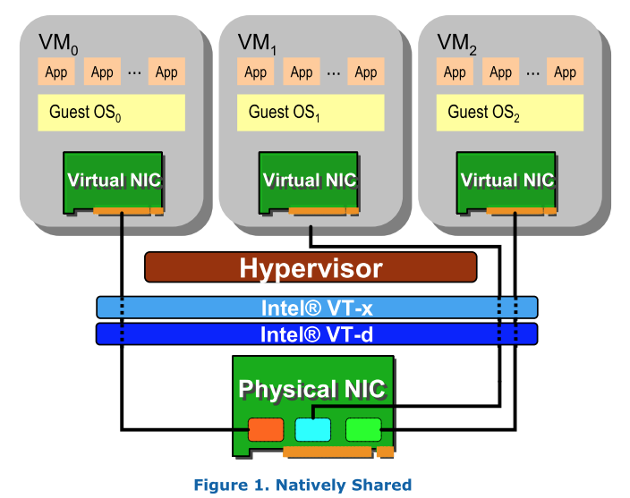
Single Root I/O Virtualization

Slide 48

Intel Virtualization Technology Evolution
Standards for IO-device sharing:
Multi-Context I/O Devices
Endpoint Address Translation Caching
Under definition in the PCI-SIG* IOVWG
Vector 3: I/O Focus
PCI-SIG
Vector 2: Platform Focus
Hardware support for IO-device virtualization
Device DMA remapping
Direct assignment of I/O devices to VMs
Interrupt Routing and Remapping
VT-d
VT-x
Establish foundation for virtualization in the IA-32 and Itanium architectures…
… followed by on-going evolution of support:
Micro-architectural (e.g., lower VM switch times)
Architectural (e.g., Extended Page Tables)
Vector 1: Processor Focus
VT-i
VMM Software
Evolution
Software-only VMMs
Binary translation
Paravirtualization
Simpler and more Secure VMM through foundation of virtualizable ISAs
Increasingly better CPU and I/O virtualization performance and functionality as I/O devices and VMMs exploit infrastructure provided by VT-x, VT-i, VT-d
Past No Hardware Support
Today
VMM software evolution over time with hardware support
*Other names and brands may be claimed as the property of others

Slide 49
Summary

Slide 50
Computer System Organization
CPU
Memory
MMU
Controller
Local Bus
Interface
High-Speed
I/O Bus
NIC
Controller
Bridge
Frame Buffer
LAN
Low-Speed
I/O Bus
CD-ROM
USB

Slide 51
Guest Domain
Domain-0
Application
Qemu (User-level)
TCP/IP Stack
TCP/IP Stack
Device Driver (8139)
Real Device Driver
Xen
Hardware
Physical Device

Slide 52
Guest Domain
Domain-0
Application
TCP/IP Stack
TCP/IP Stack
Frontend Dev Driver
Backend Dev Driver
Real Device Driver
Xen
Split Device Driver
Hardware
Physical Device

Slide 53
Summary of I/O Virtualization
VM
Guest OS
CPU
Memory
MMU
Controller
Local Bus
Interface
High-Speed
I/O Bus
NIC
Controller
Bridge
Frame Buffer
LAN
Low-Speed
I/O Bus
CD-ROM
USB

Slide 54
Memory Isolation w/ Direct Access Device
VM
Guest OS
CPU
Memory
MMU
Controller
Local Bus
Interface IOMMU
High-Speed
I/O Bus
NIC
Controller
Bridge
Frame Buffer
LAN
Low-Speed
I/O Bus
CD-ROM
USB

Slide 55
Virtualization Enabled Device
VM1
Guest OS
VM2
Guest OS
CPU
Memory
MMU
Controller
Local Bus
Interface IOMMU
High-Speed
I/O Bus
vNIC 1
vNIC 2
Frame Buffer
NIC
Controller
Bridge
LAN
Low-Speed
I/O Bus
CD-ROM
USB

Slide 56
Control Flow of Pressing ‘a’ and Displaying ‘a’
Keyboard triggers an interrupt. (Suppose currently VM is running)
VMExit! Jump to host Linux’s interrupt handler (non-root -> root)
Host Linux driver gets the character ‘a’
Host Linux returns to Qemu (kernel -> user)
Qemu notices an I/O inputs in its main loop, updates its emulated keyboard device states (write ‘a’ to an emulated register of the emulated keyboard)
Qemu puts a virtual interrupt in guest’s VMCS, and use ioctl to resume VM (user -> kernel) (root -> non-root)

Slide 57
Control Flow of Pressing ‘a’ and Displaying ‘a’
VM finds the keyboard interrupt, jumps to interrupt handler (user -> kernel)
VM driver starts to run, it tries to read keyboard’s register to find out which key is pressed, by ‘in 0x100 %eax’, which will trap (non-root -> root)
VMExit! Host Linux gives control to Qemu (kernel -> user)
Qemu finds the reason is I/O instruction, then retrieves the instruction and emulates it, by reading the states of emulated keyboard, gets a value ‘a’ (which is just written by Qemu itself)
Qemu updates VMCS->eax, and starts to run VM (user-> kernel) (root -> non-root)
VM resumes and gets the value in %eax, which is ‘a’
Guest OS returns the value to user application (kernel -> user)

Slide 58
Virtualization Techs
Virtualization | Software Solution | Hardware Solution
CPU | Trap & Emulate Instruction interpretation Binary translation Para-virtualization: no 17 insns | VT-x Root / non-root mode VMCS
Memory | Shadow page table Separating page tables for U/K Para-virtualization: Direct paging | EPT
I/O | Direct I/O Device emulation Para-virtualization: Front-end & back-end driver (e.g., virtio) | IOMMU SR-IOV

Slide 59
for Security

Slide 60
Virtualization Preliminary: VT-x
VM
Ring 3
Ring 0
guest mode
VM entry
VM exit
host mode
Hypervisor
Notes:
Besides traditional privilege rings on the processor, VT-x introduced a new host mode.
Hypervisor is designed to run in host mode. All privileged operations in guest mode would cause trap into host mode, ie, Vmexit.

Slide 61
Interposition with CloudVisor
VM
Ring 3
Hypervisor
Ring 0
guest mode
VM entry
VM exit
VM entry
VM exit
host mode
Cloudvisor
Notes:
Cloudvisor interposes hypervisor and vms...
In this way, some sensitive states (general purposed registers) could be saved during VMExit.

